Slide 1
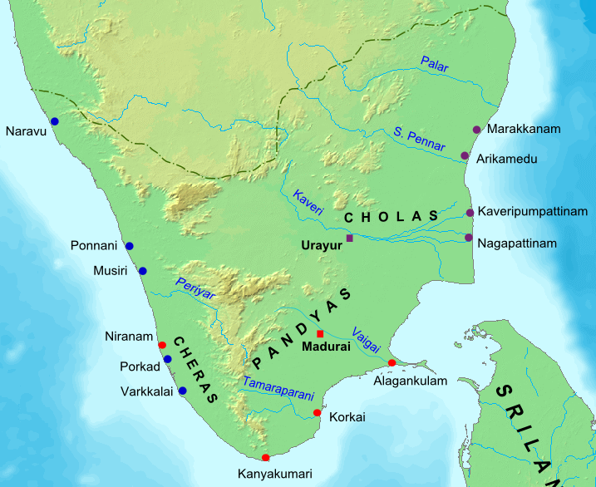
ANCIENT
TAMILAKAM
ANCIENT
TAMILAKAM
ANCIENT
TAMILAKAM

Slide 2
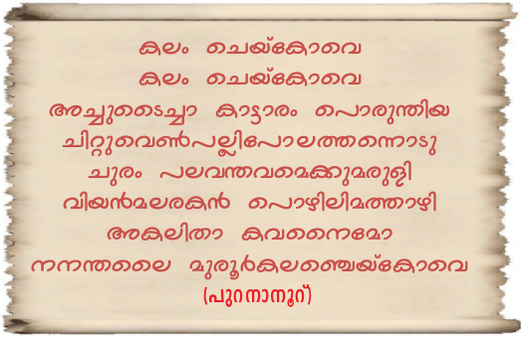

Slide 3
O potter
Like a tiny white lizard hugging the spoke of a turning cart wheel is carried to places afar, I have been a part of all his joys and sorrows. He has passed away now.
Make sure the urn for his burial is wide enough for me too.

Slide 4
Given above is an ancient Tamil song of Sangam period
Did we get any information from these songs about the Sangam age ?

Slide 5
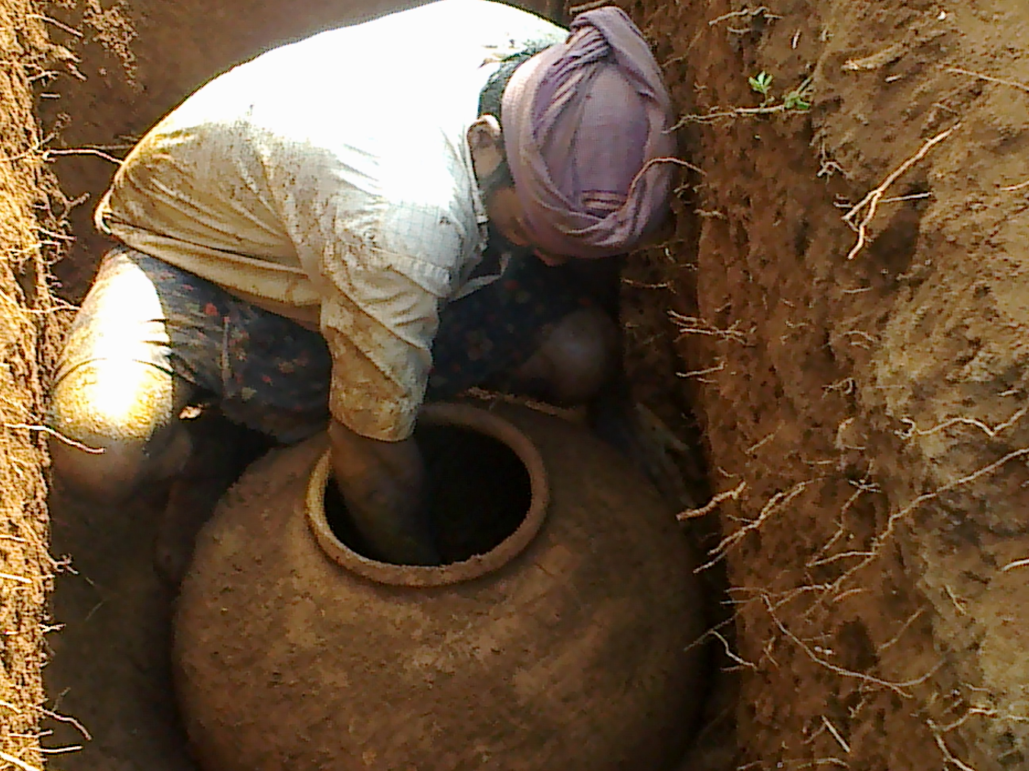
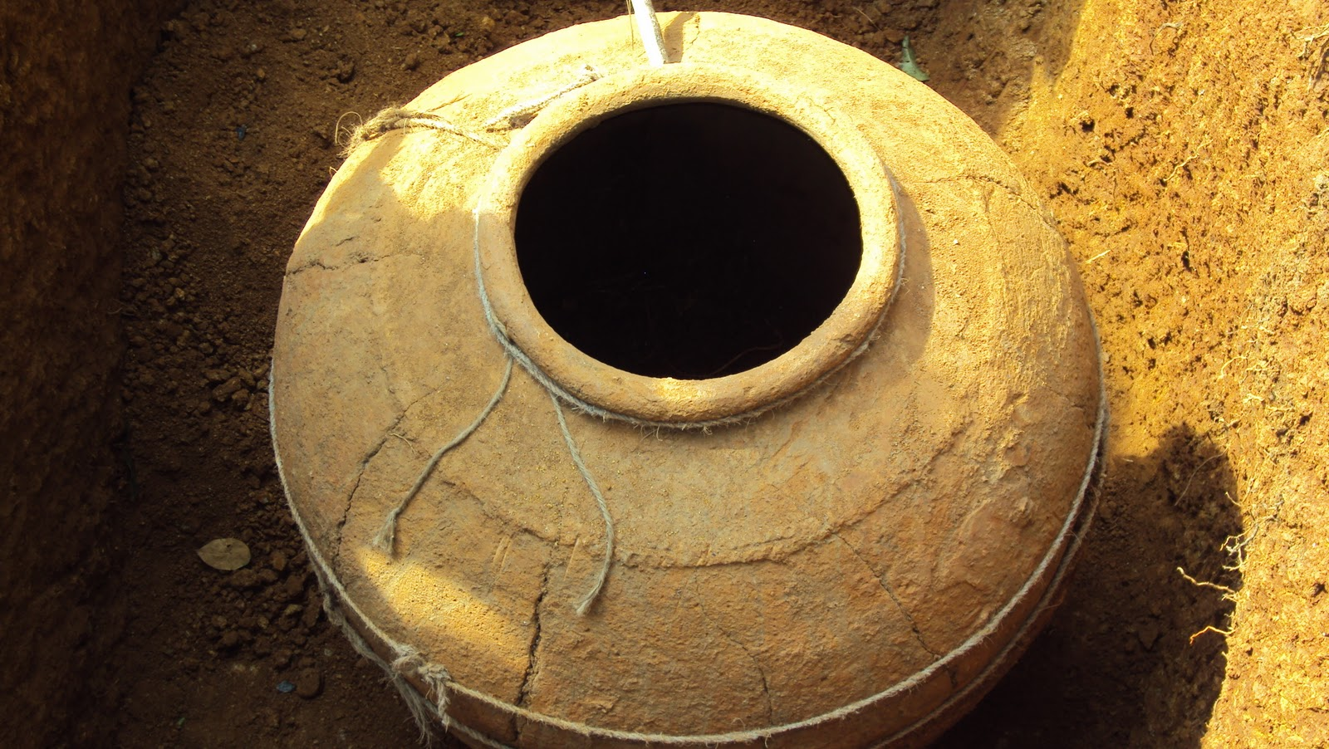
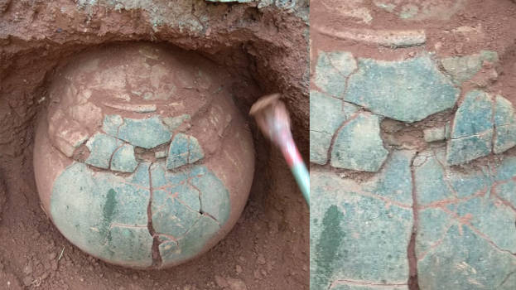
Urn burials ( Nannangadi )

Slide 6
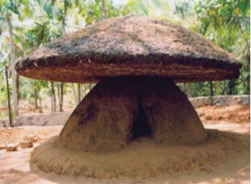
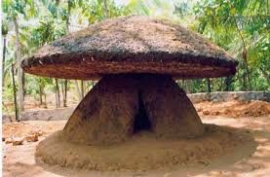
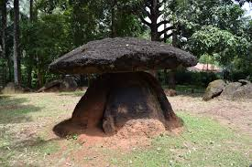
Umbrella Stone ( kudakkallu )

Slide 7
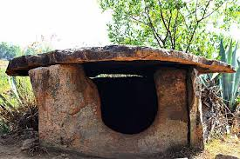
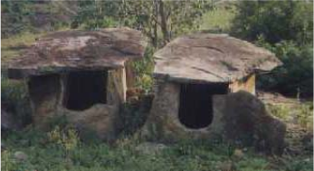
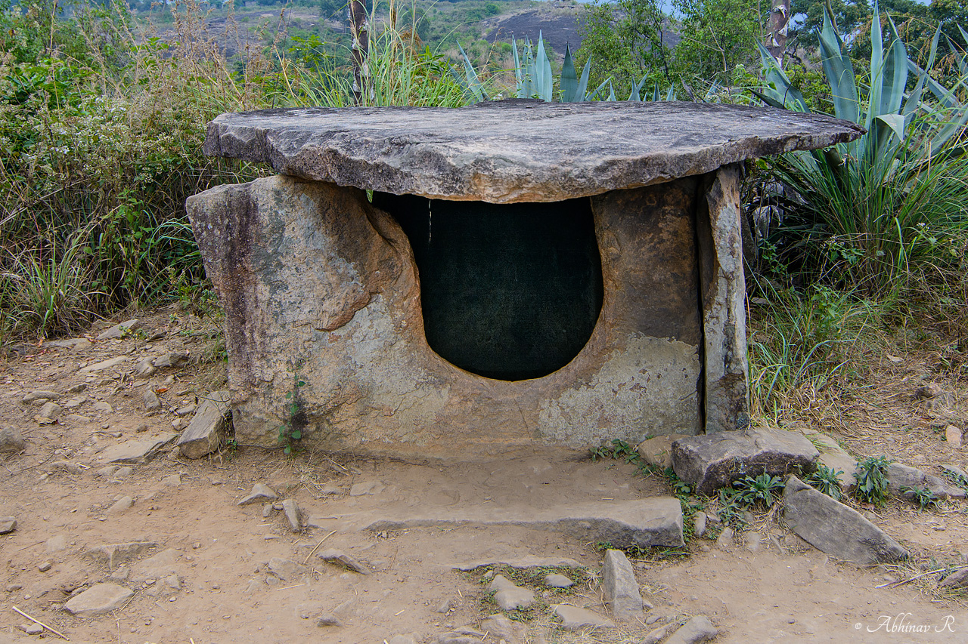
Dolmens

Slide 8
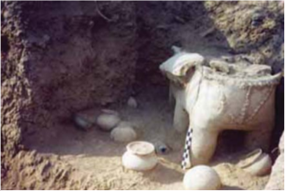
Sarcophagus

Slide 9
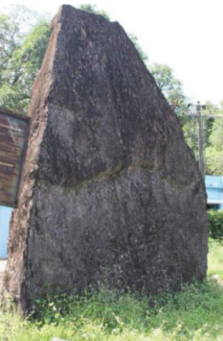
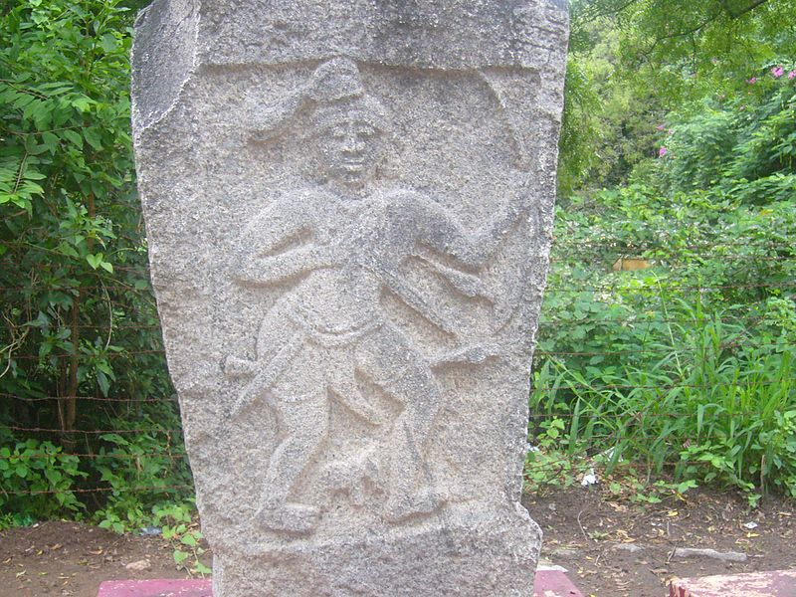
Menhir

Slide 10
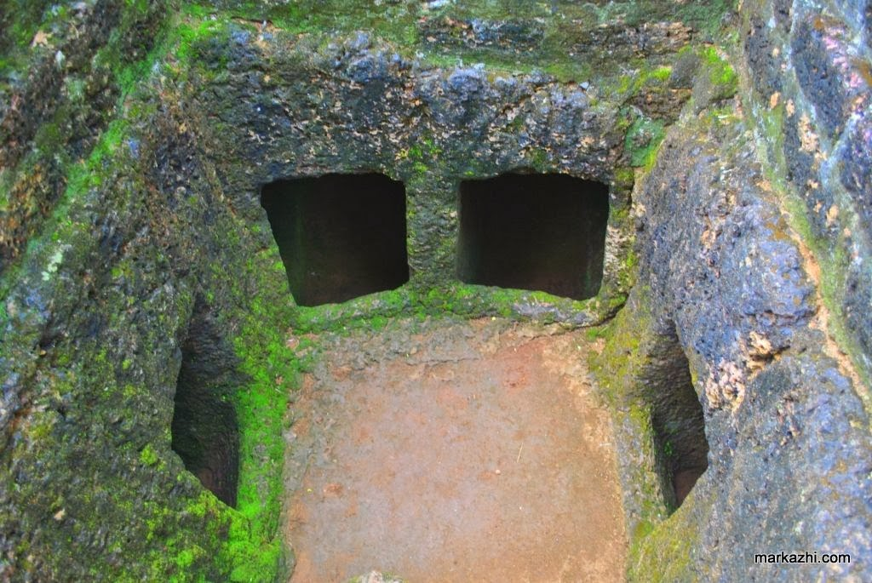
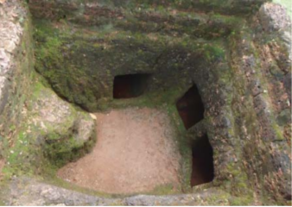
Rock chamber

Slide 11
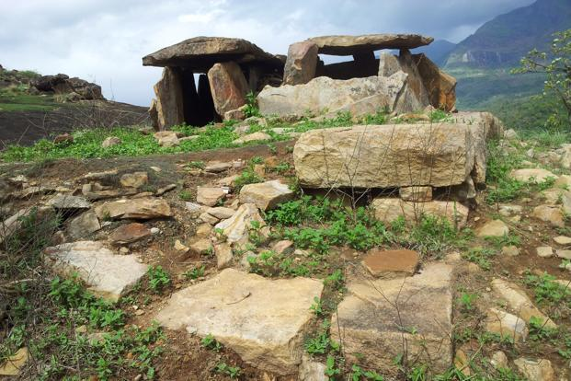
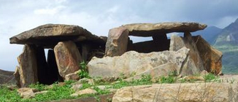
Cists

Slide 12
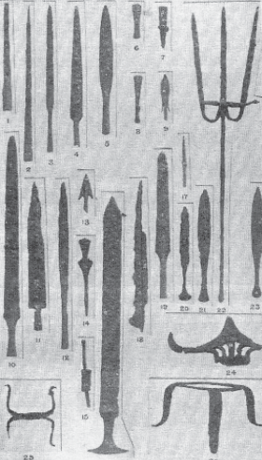
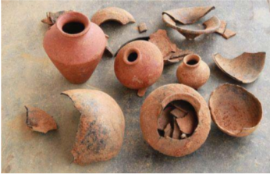
Iron tools , Clay pots

Slide 13
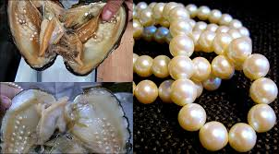
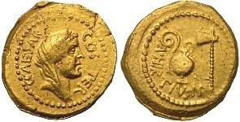
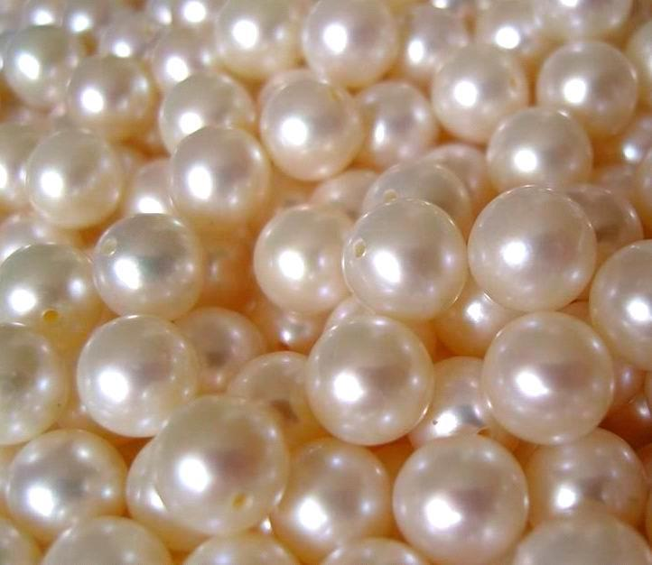
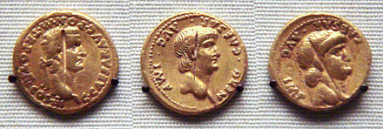
Beads, Roman coins

Slide 14
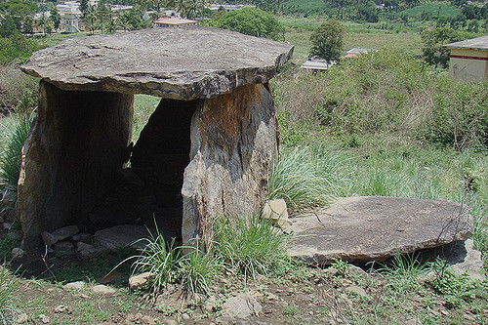
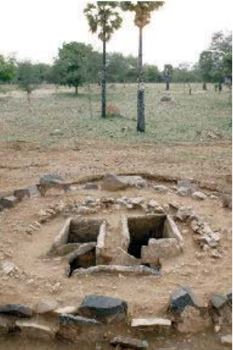
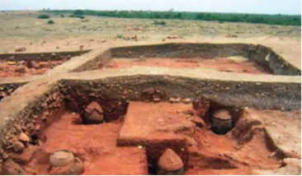
Major Megalithic Excavation sites

Slide 15
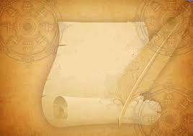
Sangam
Literature

Slide 16
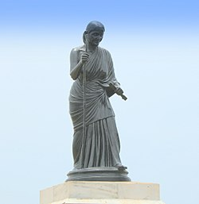
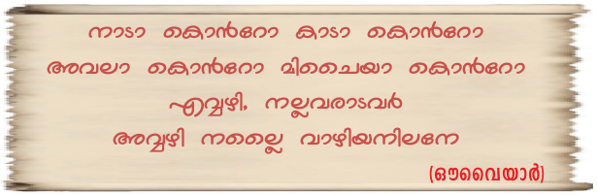

Slide 17
O earth!
Whether you are plain or jungle
Hill or valley
You are good only if the virtuous folks reside there
You have no virtue of your own

Slide 18
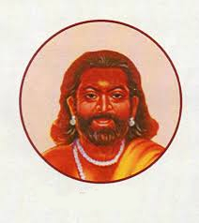
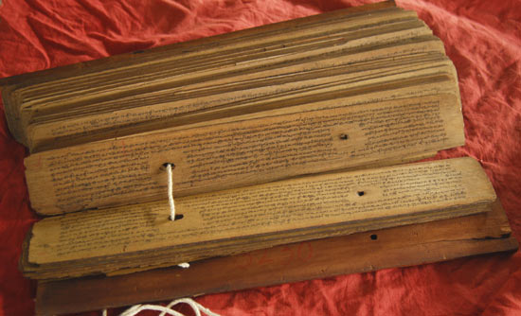
Mathurainakkeeran
KAPILAR
Paranar

Slide 19
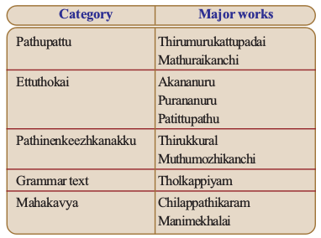
SANGAM WORKS

Slide 20
Complete the table
Category | Major works
...................... | Thirumurukattupadai Mathuraikanchi
Ettuthokai | Akananuru ........................... Patittupathu
Pathinenkeezhkanakku | .............................. Muthumozhikanchi
............................ | Tholkappiyam
Mahakavya | ........................ Manimekhalai

Slide 21
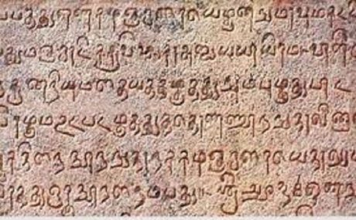
The ancient Tamil songs
Akampattukal
The theme is mainly personal and family affairs
Purampattukal
Treat external affairs like war and trade
The Sangam literature illustrates the physiography,
plentiful resources, food habits, dressing patterns, ornaments,
recreational activities, customs, major occupations, and beliefs
of the period.

Slide 22
Social life
Ancient Tamilakam was divided into different Tinais. Each Tinais had its on distinguish geographical features.
The Tinais had an important role in moulding the social life of ancient Tamilakam..

Slide 23
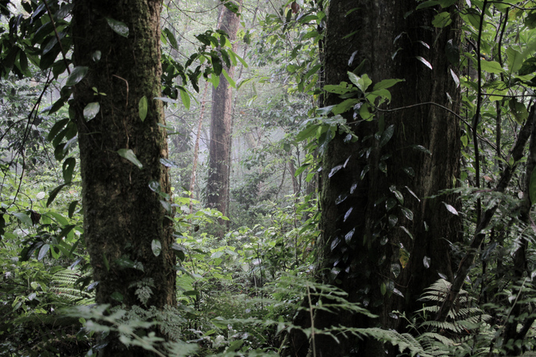
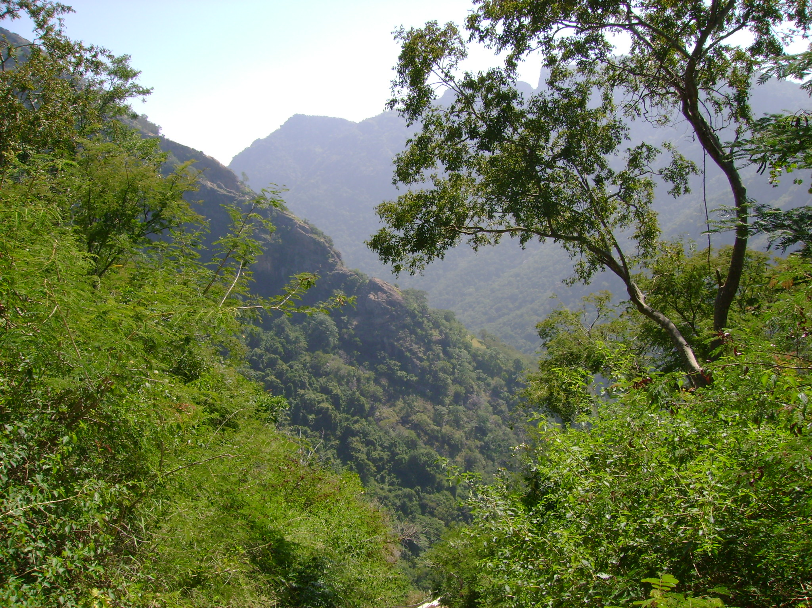
Kurinchi
Hilly area
Hunting and collecting of forest resources
Engaged in shifting cultivation
Pepper and other spices were cultivated

Slide 24
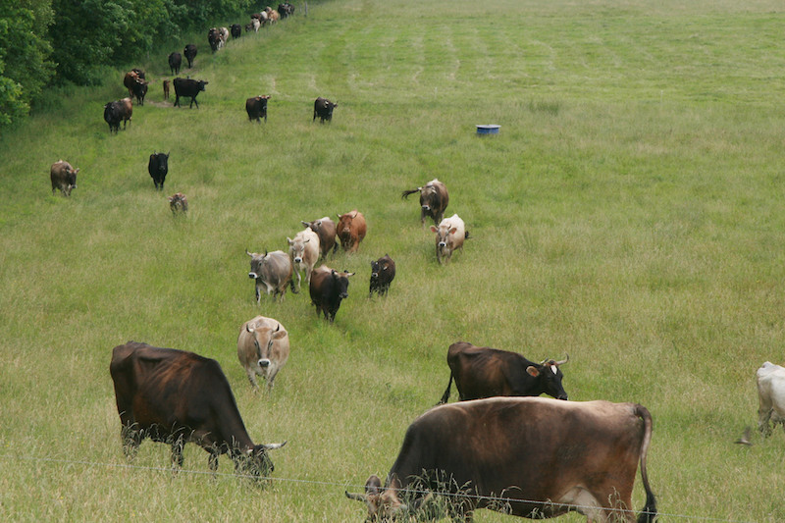
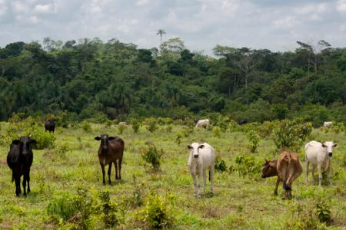
Mullai
The grassland
Rearing of cattle was the major occupation
Vetchi - The practice of seizing cattle prevailed

Slide 25
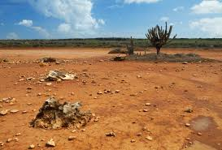
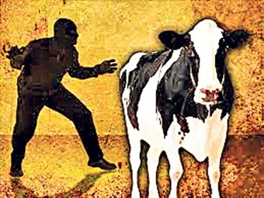
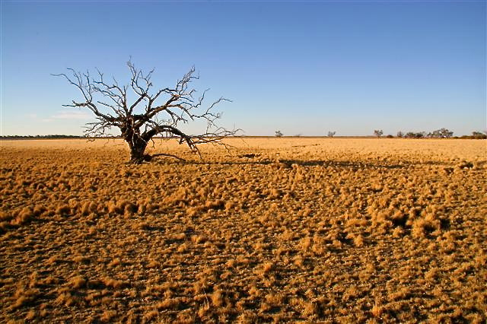
Palai
Dry lands
Chiefly engaged the stealing cattle

Slide 26
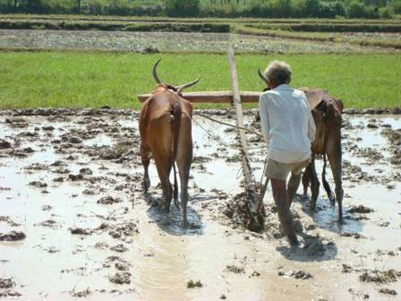
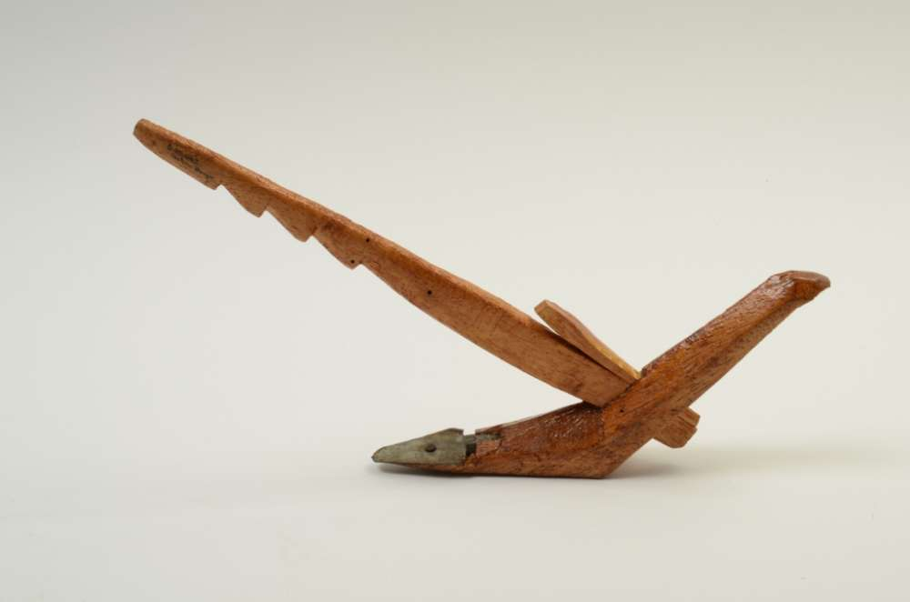
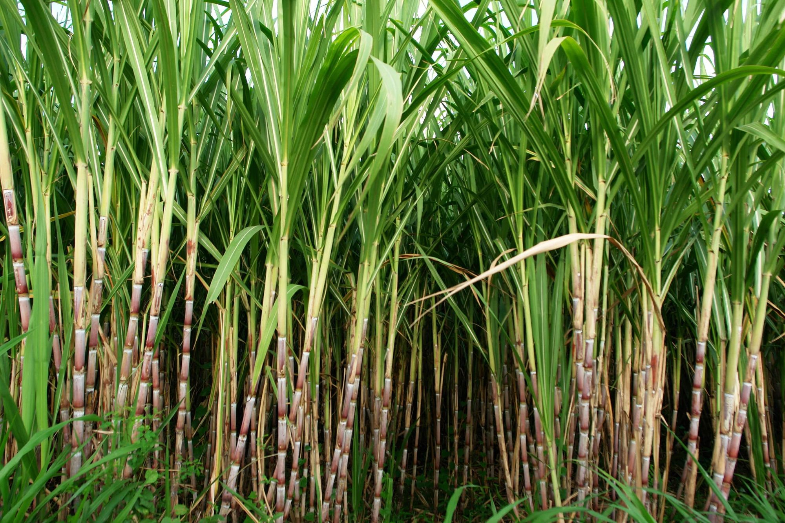
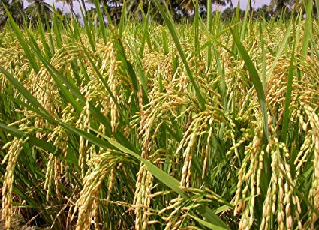
Marutam
Wetland
Rice and sugarcane were cultivated
Used iron ploughshare affixed to plough

Slide 27
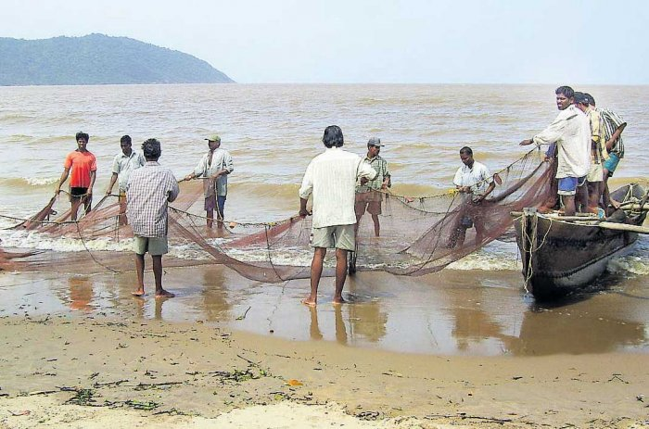
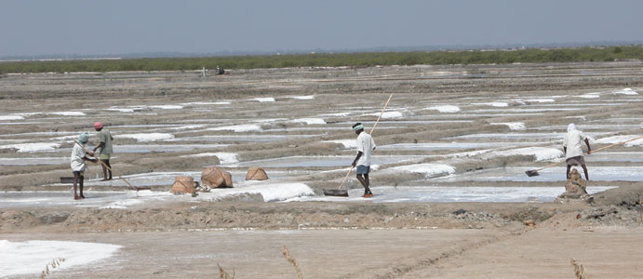
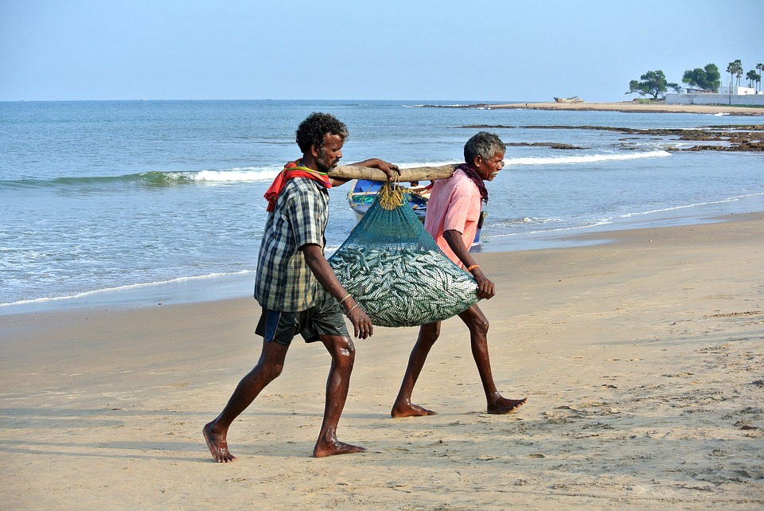
Neytal
Coastal region.
Fishing and salt production were the major occupation

Slide 28
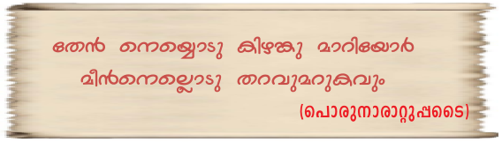
Exchange system
People procure fish and rice by exchanging
honey, ghee and tubers

Slide 29
What information do you get from the above songs about the exchange systems of ancient Tamilakam ?

Slide 30
Sangam literature mentions the practice of exchange of goods known as Noduthal.

Slide 31
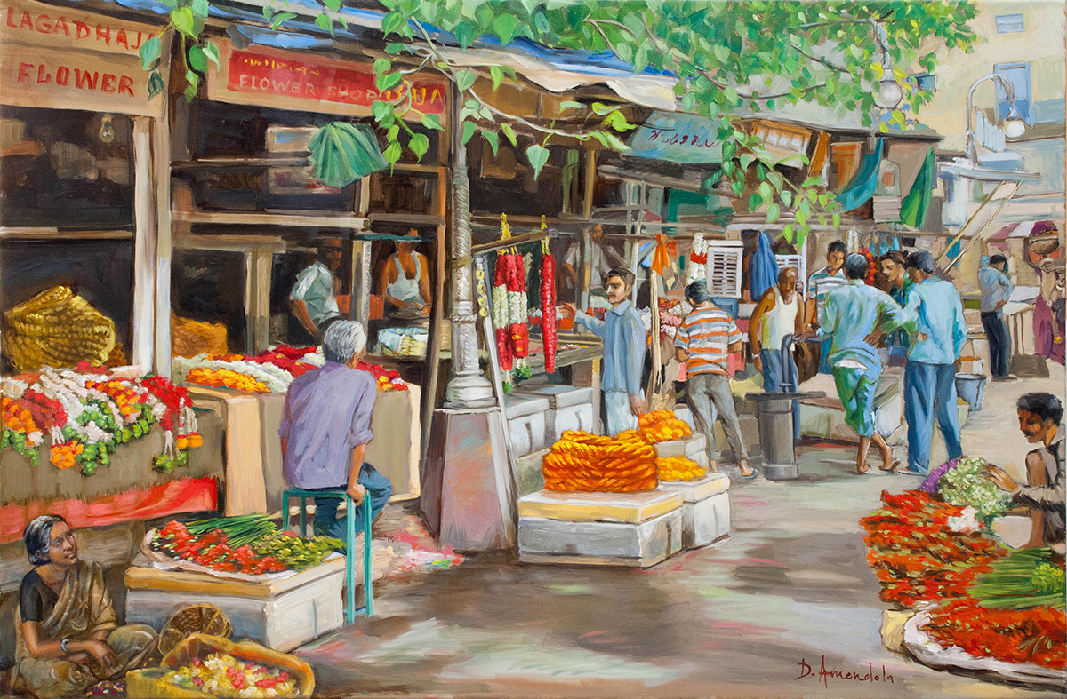


Allalavanam (evening market)

Slide 32



Nalangadi (morning market)
The commodities for daily use
in different Tinais were obtained
from these markets.

Slide 34


Merchant Groups
In those days salt was an important commodity of exchange
This exchange was done by the
merchant group called Umanar.
Umanar also exchanged spices, the major export commodity in ancient Tamilakam.

Slide 35


Merchant Groups
Umanar collected dried fish and salt from the coastal area.
exchanged it for spices like pepper and forest products of other Tinais
These exchanges were largely done during summer.

Slide 36
Why was summer suitable for this exchange?
Summer is the harvest season.
Salt and dried fish were made in summer.

Slide 37

Foreign Trade
The spices collected by the Umanar were sold at trade centres in coastal towns.
from there they were exported to foreign countries.

Slide 38
Trade with Romans
The Roman coins discovered from the megalithic monuments is the evidence for trade relation between Tamilakam and the Romans.
The major commodities that the
Romans took from ancient Tamilakam were the spices; especially pepper.

Slide 39

Power Centres
Trade was controlled by three power centres known as Moovendans
the Cheras, the Pandyas, and the Cholas. They were together called Moovendans

Slide 40

Moovendans
Capitals
The Cheras - Muchiri
The Pandyas - Madurai
The Cholas - Uraiyur
Muchiri, Thondi, Vakai, Mantai, Kaveripattanam, etc. were the major port cities of the period

